Slide 1
Earning Forecast
Group: SMRMJ
GAO Jun 120090240
LIU Xinyu 120020128
MA Kexuan 120090651
SHEN Hengyu 120090633
ZHANG Haoshen 120090798

Slide 2
Content
Description of model
Predictions and Intuition
Discussion of Results
Out-of-sample Testing
Content
Description of model
Predictions and Intuition
Discussion of Results
Out-of-sample testing
Notes:
Offsetting 和Engaging 再确认一下

Slide 3
PART 1 Description of Model

Slide 4
Description of Model and Variables
Our prediction model is as follows:
Earn_{t+1} = α₀ + α₁ EARN_{t} + α₂ ATR+ α₃ GPM + α₄ FLR
AFE_{t+1} = β₀ + β₁ AFE_{t} + β₂ ATR + β₃ GPM + β₄ FLR
where Earn is earnings measured as a fraction of assets. AFE is analyst forecast error as a fraction of assets. ATR is asset turnover ratio. GPM is the gross profit margin. FLR is the financial leverage ratio.
Content
Description of model
Predictions and Intuition
Discussion of Results
Out-of-sample testing

Slide 5
Description of Model and Variables
Formal definitions of the variables are as follows::
ATR Asset Turnover Ratio: Revenue / Avg Total Asset;
WRDS: REVT/AT (avg)
GPM Gross Profit Margin: (Sales-COGS) / Sales;
WRDS: (SALE-COGS) / SALE
FLR Financial Leverage Ratio: Avg Total Asset / Shareholders’ Equity;
WRDS: AT (avg) / SEQ (avg)
Content
Description of model
Predictions and Intuition
Discussion of Results
Out-of-sample testing

Slide 6
Description of Model and Variables----Industry-Adjusted
What is Industry-adjusted?
Industry-adjusted data is the specific data forms computed as correlated equations being adjusted by the median data of the firms in Compustat in a given six-digit GICS industry code and year.
Why we need to do this industry adjustment?
Cannot compare companies from different industries through specific factors.
Content
Description of model
Predictions and Intuition
Discussion of Results
Out-of-sample testing

Slide 7
PART 2
Predictions and Intuition

Slide 8
Description of Model and Variables
Formal definitions of the variables are as follows::
ATR Asset Turnover Ratio: Revenue / Avg Total Asset;
WRDS: REVT/AT (avg)
GPM Gross Profit Margin: (Sales-COGS) / Sales;
WRDS: (SALE-COGS) / SALE
FLR Financial Leverage Ratio: Avg Total Asset / Shareholders’ Equity;
WRDS: AT (avg) / SEQ (avg)
Content
Description of model
Predictions and Intuition
Discussion of Results
Out-of-sample testing

Slide 9
Predictions and Intuition----ATR
ATR
Asset Turnover Ratio: Revenue / Avg Total Asset;
AT(avg)=1/2*(AT_{t-1}+AT_{t})
WRDS: REVT/AT (avg)
α₂>0
β₂>0
Content
Description of model
Predictions and Intuition
Discussion of Results
Out-of-sample testing

Slide 10
Predictions and Intuition----GPM
GPM
Gross Profit Margin: (Sales-COGS) / Sales;
WRDS: (SALE-COGS) / SALE
α₃>0
β₃>0
Content
Description of model
Predictions and Intuition
Discussion of Results
Out-of-sample testing

Slide 11
Predictions and Intuition----FLR
FLR
Financial Leverage Ratio: Avg Total Asset / Shareholders’ Equity;
WRDS: AT (avg) / SEQ (avg)
α₄=0
β₄>0
Content
Description of model
Predictions and Intuition
Discussion of Results
Out-of-sample testing

Slide 12
PART 3
Discussion of Results

Slide 13
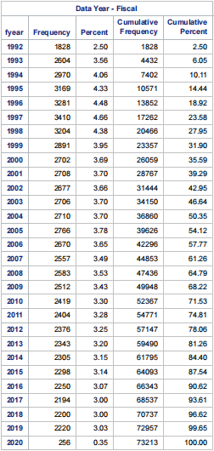
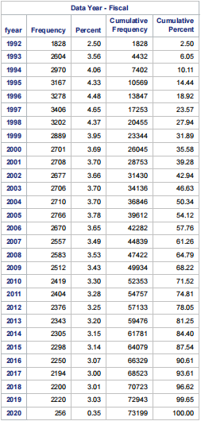
Discussion of Results----Number of Observations
Not-adjusted
Industry-adjusted
Content
Description of model
Predictions and Intuition
Discussion of Results
Out-of-sample testing

Slide 14
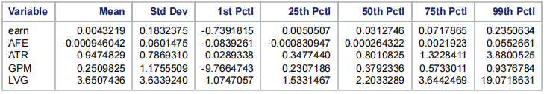
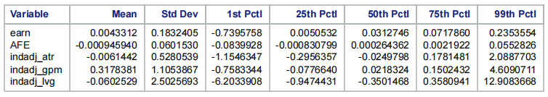
Discussion of Results----Descriptive Statistics
Not-adjusted
Table 1
Industry-adjusted
Table 2
Content
Description of model
Predictions and Intuition
Discussion of Results
Out-of-sample testing

Slide 15
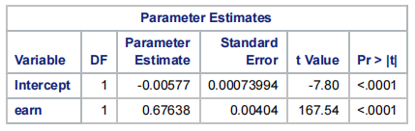
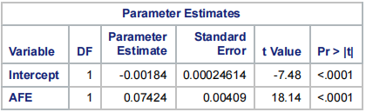
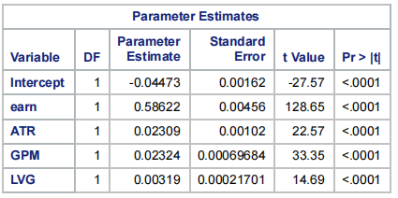
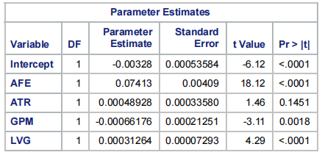
Discussion of Results----Regression Results (Not-adjusted)
Regression-Earn
Regression-AFE
Table 1
Table 2
Content
Description of model
Predictions and Intuition
Discussion of Results
Out-of-sample testing

Slide 16
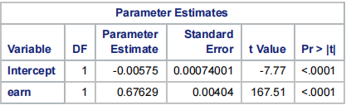
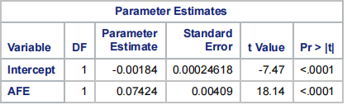
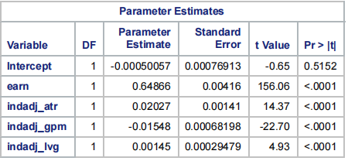
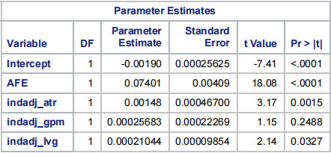
Discussion of Results----Regression Results (Industry-adjusted)
Regression-Earn
Regression-AFE
Content
Description of model
Predictions and Intuition
Discussion of Results
Out-of-sample testing

Slide 17
PART 4
Out-of-sample Testing

Slide 18
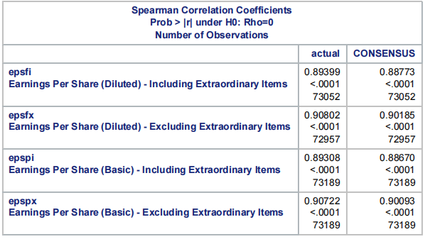
Out-of-sample Testing
Content
Description of model
Predictions and Intuition
Discussion of Results
Out-of-sample testing

Slide 19
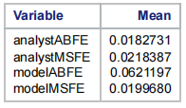
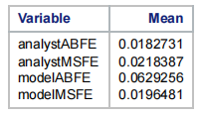
Out-of-sample Testing
Not-adjusted
Industry-adjusted
Content
Description of model
Predictions and Intuition
Discussion of Results
Out-of-sample testing

Slide 20
Question & Answer
Q&A

Slide 21
THANKS!

